Slide 1



Patient Care Coordination Domain Update Tone Southerland, Ready Computing Denise Downing, Association of periOperative Registered Nurses
Webinar Series 2014
http://ihe.net/Webinars/

Slide 2
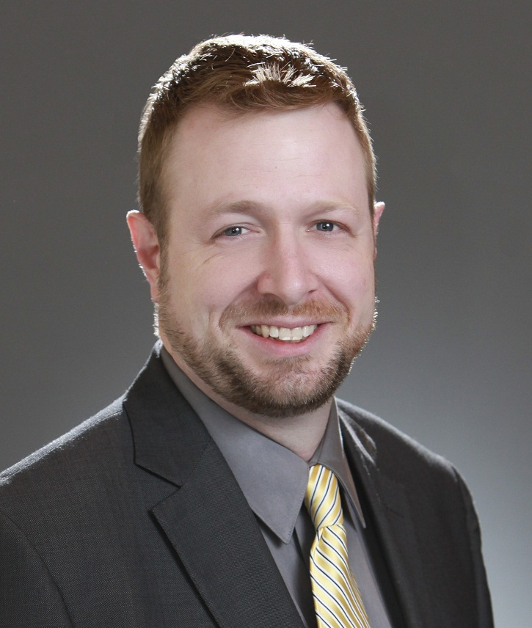
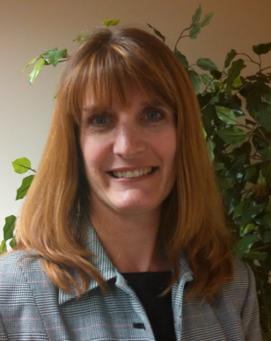
Today’s Presenters
Tone Southerland
Planning Committee Chair, IHE PCC
Standards and Interoperability Architect, Ready Computing
Denise Maxwell-Downing, MS, BSN, RN
Planning Committee Nursing Chair, IHE PCC
Perioperative Informatics Nurse Specialist, AORN – Assoc of periOperative Registered Nurses

Slide 3
Agenda
PCC Domain Vision and Mission
PCC Roadmap
Content, Workflow, Nursing
PCC Domain Profiles & Technical Frameworks
Existing Profiles
New Profiles
How to Participate
IHE International Membership
Planning & Technical Committees
Q&A Session

Slide 4
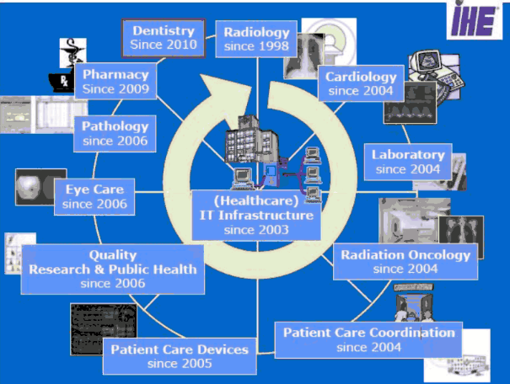
IHE Domains

Slide 5
PCC Vision and Mission
Vision: The vision of Patient Care Coordination is to continually improve patient outcomes through the use of technology connecting across healthcare disciplines and care paths.
Mission: The mission of Patient Care Coordination is to develop and maintain interoperability profiles to support coordination of care for patients where that care crosses providers, patient conditions and health concerns, or time.
Notes:
Meetings at F2F this week
Vision key words: continually, across

Slide 6
PCC Roadmap Strategic Goals
Content
Coordinate with external standards development organizations (SDOs) to develop and promote the use of content templates
Develop strategies to support multi-level content template guidance to benefit the global community
Workflow
Develop new profiles by reaching outward to other IHE domains to coordinate workflows across care paths
Develop white papers by researching new areas that could benefit from standards based interoperability guidance
Nursing
Explore and understand the benefit of IHE profile work in the nursing space by partnering with nursing organizations and initiatives
Develop profiles and white papers to support and explore various nursing specific workflows
Notes:
Content: re-evaluating our role here
Workflow: flip “catch-all” model and start reaching outward
Nursing: history of subcommittee; worthy of its own domain

Slide 7
PCC Scope
Scope
General clinical care aspects such as document exchange, order processing and coordination with other specialty domains.
Workflows and integration needs that are common to multiple specialty areas.
Sponsors
Health Information and Management Systems Society (HIMSS)
American College of Physicians (ACP)
Countries actively involved in committees
United States
Canada
Italy
France
Netherlands

Slide 8
PCC History
History
IHE PCC was formed in 2004
The committee’s first profile was also IHE’s first content profile: XDS-MS. The profile was delivered in September of 2005 for Trial Implementation.
Since then, PCC has created 23 content profiles, 5 workflow profiles, and 7 integration profiles.
The IHE PCC Technical Framework is used in national programs in the US, France, Italy, the EU and Asia (China, Saudi Arabia, others).

Slide 9
Profiles & Technical Frameworks Overview
IHE Technical Frameworks
http://ihe.net/Technical_Frameworks/#pcc
IHE Profiles developed by PCC
http://wiki.ihe.net/index.php?title=Profiles#IHE_Patient_Care_Coordination_Profiles
Learn More
Webinar Series http://ihe.net/Webinars/
Notes:
- Jump out to browser and show ihe.net site
Archived webinars available on ihe.net for PCC profiles
Note on availability of older webinar videos

Slide 10
Profiles & Technical Frameworks Existing High Uptake Profiles
Medical Summaries (XDS-MS)
Discharge and Referral Summaries exchanged between providers
EHR and HIS solutions
Ensures adequate exchange of data for referrals and transitions of care between inpatient and ambulatory settings.
Emergency Department Referral (EDR)
Enhances XDS-MS to support “Heads-up” call to ED
EHR, EDIS, HIS, HIE
Provides critical data needed in ED visits
Exchange of Personal Health Records (XPHR)
Exchange Clinical Summary data with patients
EHRs, PHRs, Patient Portals
Ensures that patients have updated lists of healthcare providers, problems, medications, allergies, immunizations, lab results, procedures and encounters
Notes:
Many profiles share same section and entry templates

Slide 11
Profiles & Technical Frameworks Existing Profiles for Clinical Decision Support
Query for Existing Data (QED)
Access to clinical data (problems, medications, allergies, results, procedures, encounters)
EHR, CDR, HIS, Registries
Provides access to clinical data for use in quality measurement, reporting, clinical decision support, and research
Care Management (CM)
Supports communication to specialized care delivery systems for disease management
Request for Clinical Guidance (RCG)
Access to Clinical Decision Support
EHR, other HIT Systems
Provides standardized interface to access clinical decision support as a service
Retrieve Clinical Knowledge (RCK)
How Health IT systems, Personal Health Records, and HIEs can retrieve clinical knowledge on a topic suitable for presentation to a clinician or patient

Slide 12
Profiles & Technical Frameworks Existing Profiles for Emergency Care
Transport Record Summary Profiles
Documents care that occurs during patient transport
Fixed wing, helicopter, ambulance
EHR, EDIS, Transport Team
Emergency Department Encounter Summary (EDES)
Documents care in an ED encounter
EHR, EDIS, other HIT Systems
Provides critical information for patients and providers after an ED visit.
Notes:
Transport Record Summary:
- Emergency Department Transport Summary (ETS)
- Interfacility Transport Summary (ITS)
Emergency Department Encounter Summary
- Composite Triage and Nursing Note (CTNN)
- ED Physician Note (EDPN)
- Nursing Note (NN)
- Triage Note (TN)

Slide 13
Profiles & Technical Frameworks Existing Profiles for Obstetric, Pediatric
Antepartum Profiles:
Antepartum H&P (APHP)
Antepartum Summary (APS)
Antepartum Laboratory (APL)
Antepartum Education (APE)
Labor and Delivery Profiles:
Labor and Delivery H&P (LDHP)
Labor and Delivery Summary (LDS)
Maternal Discharge Summary (MDS)
Postpartum Visit Summary (PPVS)
Pediatric
Newborn Discharge Summary (NDS)
Immunizations
Immunization Content (IC)

Slide 14
Profiles & Technical Frameworks Existing Profiles for Workflow
Cross Enterprise Basic eReferral Workflow Definition (XBeR-WD)
Builds on ITI XDW to manage the workflow related to an eReferral
Cross Enterprise Tumor Board Workflow Definition (XTB-WD)
Builds on ITI XDW to manage the workflow related to managing the multidisciplinary tumor board review
Early Hearing Detection and Intervention-Workflow Definition (EHDI-WD)
Builds on ITI XDW to manage collection and exchange of newborn hearing screening information
Cross Enterprise TeleHome Monitoring (XTHM)
Builds on ITI XDW to manage the clinical process involving chronic patients followed by telemonitoring services
Referral and Order Linking (ROL)
Makes use of new actors (order placer, order filler) to link referrals created in disparate systems
Includes use cases across a variety of health care settings
Perinatal Workflow (PW)
Notes:
- ROL is different as there is no dependency on transport like the XDW based profiles are

Slide 15
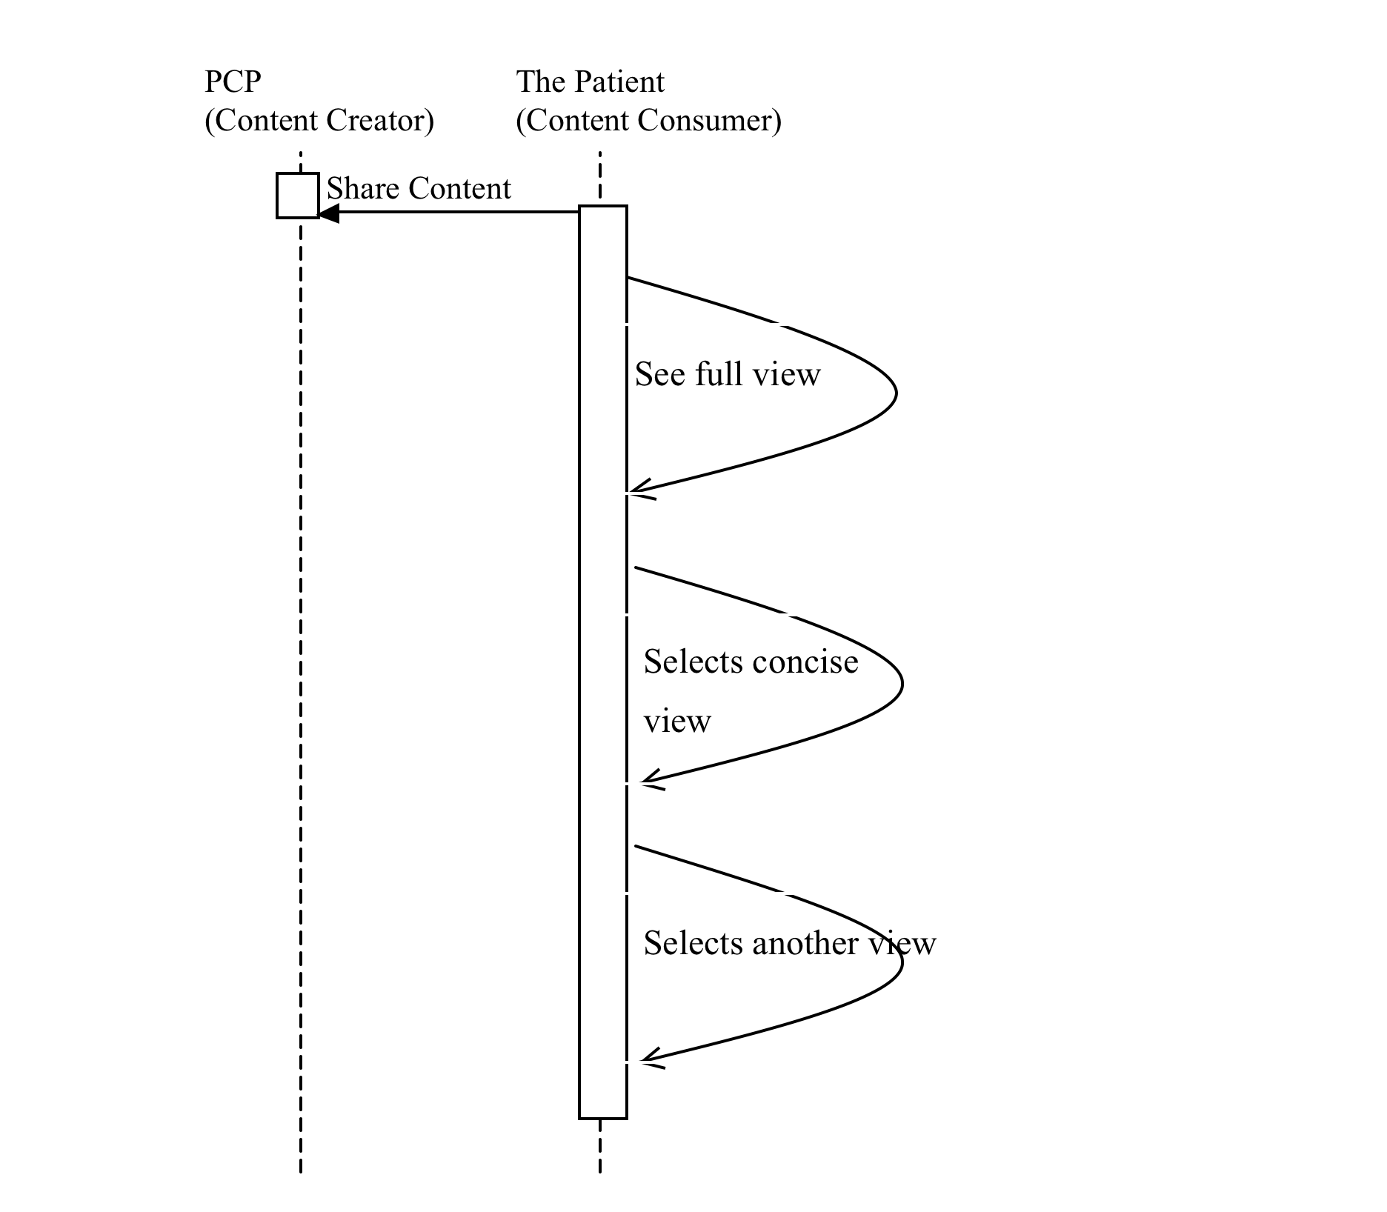
Profiles & Technical Frameworks New Profiles in Development – Multiple Content Views (MCV)
Provides guidance on how text in CDA documents may be tagged to achieve different rendering behaviors
Focus is on the narrative text, not the entries
Can be applied to many PCC content profiles, across several use cases

Slide 16
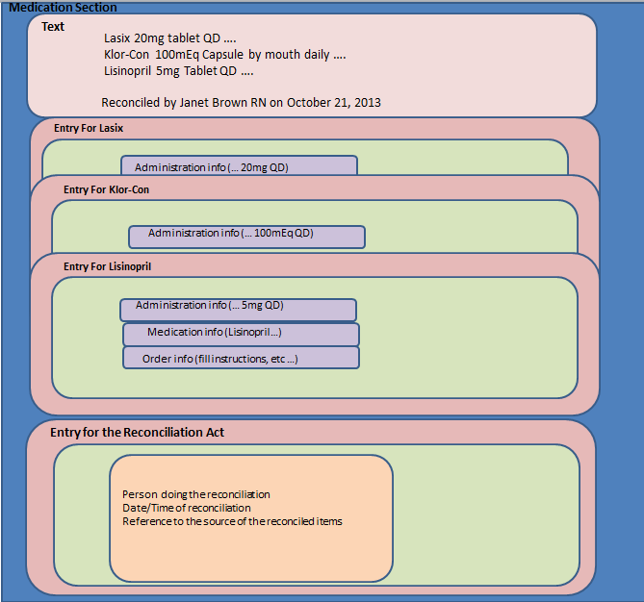
Profiles & Technical Frameworks New Profiles in Development – Reconciliation (RECON)
Clinical Content and Care Providers - updated version now includes:
medications, problems, allergies, immunizations, results, observations, goals, care providers
From multiple facilities, over multiple periods of time and different clinical events
Increases patient safety by providing mechanism to reconcile information

Slide 17
Profiles & Technical Frameworks White Paper – A Data Access Framework using IHE Profiles
Describes a framework by which IHE profiles can support multiple means of access through a modular framework with substitutable components (profiles)
Supports use cases around individual and population health
Identifies gaps in existing profiles to meet use cases and requirements
Enterprise Architecture Frameworks
RM-ODP
Zachman Framework
HL7 SAIF
Approach
Why: Business dimension
What: Information dimension
How: Behavioral dimension
Where: Technology dimension
Notes:
- Does not cover harmonization of existing profiles, new profile development, new implementation guide development
RM-ODP: Reference Model of Open Distributed Processing
HL7 SAIF: Services Aware Interoperability Framework
Approach:
- Business dimension “Why” (Used to capture business requirements, policies etc.)
- Information dimension “What” (Used to capture the data model or content )
- Computational (Behavioral) dimension “How” (Used to capture behavior, collaboration, transactions)
- Engineering and Technology dimension “Where” (Used to capture the implementation aspects including platforms, standards, integration profiles etc.)

Slide 18
PCC Roadmap – Nursing Existing Profiles for Nursing
Patient Plan of Care (PPOC)
A framework for RNs contribution to the patients plan of care
Exchange of information for assessments, diagnosis, interventions, and outcomes
Defines implementation of an HL7 CDA document to represent coded nursing data elements for care planning
Sits within a larger folder
eNursing Summary (ENS)
Interoperable summary of nursing data for care transitions
Data elements by-product of an international survey
Implementation Priorities for IHE Nursing Subcommittee White Paper
Support the uptake of PPOC and eNS profiles

Slide 19
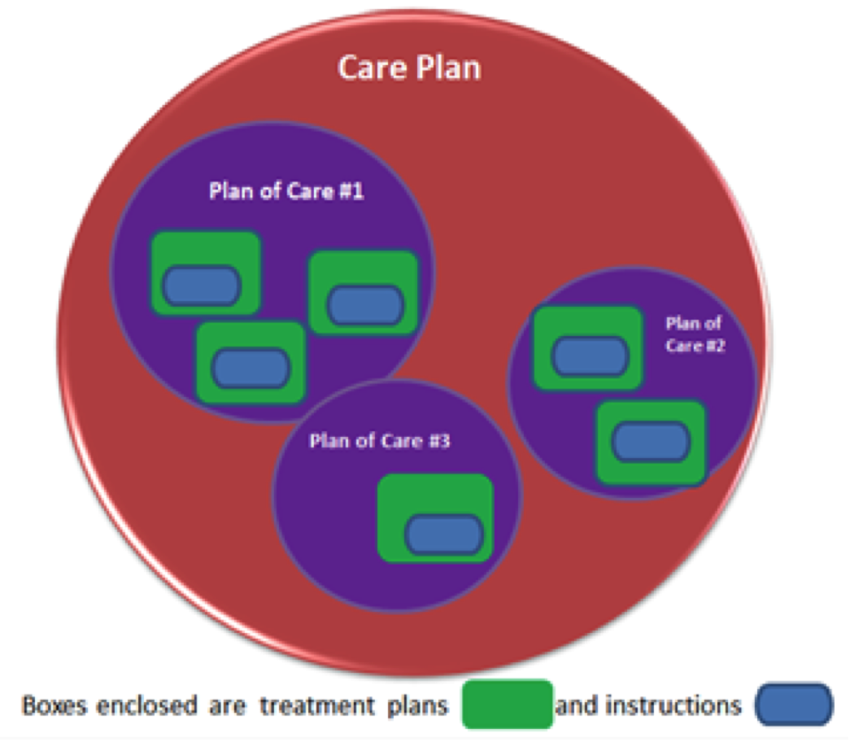
PCC Roadmap – Nursing Existing Profiles for Nursing
Patient Care Plan (PtCP)
Content profile defining a centralized care plan to meet the needs of many stakeholders
Creates opportunity for reconciliation/consolidation of disparate care plans
Addresses Treatment Plans, Plans of Care and Care Plans

Slide 20
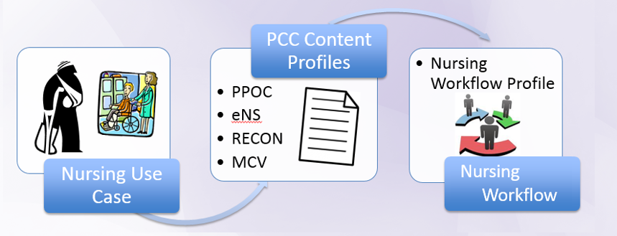
PCC Roadmap – Nursing New Directions
We have content today, need workflow tomorrow to provide further guidance on how to use that content in a meaningful way
Communication Workflows
Care Coordination Workflows

Slide 21
How to Participate in PCC IHE International Membership is Free
Apply for IHE International Organizational Membership
Visit: www.ihe.net/join
Review IHE's 400+ Organizational Members
Participate in IHE Domains & Committees
IHE Organizational Members only
13 Clinical and Operational Domains
Each Domain has one planning and one technical committee
Non-members participate in comment periods and implement IHE Technical Frameworks

Slide 22
PCC Planning Responsibilities
Planning Committee
Recruitment
Education
Review IHE Profiles Proposals
Identifies committee priorities and problems
Planning for 2014-2015
Committee Roadmap
Contact Information
ihe@himss.org
Co-chair: Laura Heermann Langford
Co-chair: Tone Southerland
pccplan@googlegroups.com
IHE.net page:
http://www.ihe.net/Patient_Care_Coordination/
Wiki page:
http://bit.ly/IHEPCCPlan
Notes:
- Reference strategy meetings at F2F in July 2014

Slide 23
PCC Technical Responsibilities
Technical Committee
Recruitment
Development of IHE Profiles
Maintenance of IHE Technical Frameworks
Projects:
Multiple Content Views (MCV)
Reconciliation (RECON)
Incoming profile development
Contact Information
ihe@himss.org
Co-chair: Emma Jones
Co-chair: Laura Bright
pcctech@googlegroups.com
IHE.net page:
http://ihe.net/Patient_Care_Coordination/
Wiki page:
http://bit.ly/IHEPCCTech

Slide 24
How to Participate in PCC? Participate IHE’s Profile Cycle
Committee work follows the IHE Profile Cycle
Annual eighteen (18) month cycle
Each IHE domain has independent schedule
Opportunities for IHE members and non-members to participate in cycle
Detailed overview of IHE Cycle next

Slide 25


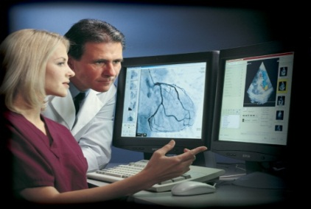


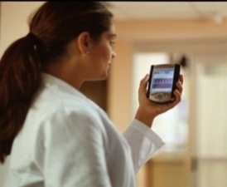
IHE Profiles Drafted & Revised
Test at IHE Connectathons
Trial
Implementation
Posted
Publish in IHE’s Product Registry
Published
For Public
Comment
months 14-18
Demonstrate at a
IHE Technical
Framework Developed
months 6-13
Profile Selection by Committees
IHE Improves, Safety, Quality and Efficiency in Clinical Settings
Install Interoperable products in Clinical Settings worldwide
IHE Call for Proposals Opens
months 1-5
Notes:
- The IHE process is iterative

Slide 26
IHE Profile Cycle Stages | Participation Status | Open Date | Close Date | Learn More
Call for Proposals | Open | Jul 9, 2014 | Sep 26, 2014 | ftp://ftp.ihe.net/Patient_Care_Coordination/Templates/IHE_Profile_Proposal_Template-Brief.docx
Profile Selection | Closed | Oct 22-23, 2014 | Nov 12-13, 2014 | http://bit.ly/IHEPCCPlan
IHE Profiles drafted in IHE Committees | Closed | Jan 2015 | May 2015 | http://bit.ly/IHEPCCTech
Public Comment | Open | Apr 2015 | Jul 2014 | IHE.net- Documents now in PC IHE’s Wiki- PC Process explained
Trial Implementation Published | Open | N/A | Aug 2015 | http://bit.ly/IHEPCCTF
IHE Connectathon Registration | Open | Aug 25, 2014 | Oct 3, 2014 | IHE N.A. Connectathon Registration
IHE Connectathon Dates | Open | Jan 26-30, 2015 |  | IHE N.A. Connectathon Resources
http://wiki.ihe.net/index.php?title=Patient_Care_Coordination
Notes:
Update this slide….

Slide 27
Learn More about IHE International Important Links and Information
All webinar recordings and slide decks will be posted online
http://ihe.net/Webinars/
Sign up for the IHE International News
Email secretary@ihe.net
Apply for IHE International Membership
http://ihe.net/Join/

Slide 28
Learn More about IHE Connectathons
IHE International Connectathons
http://ihe.net/Connectathon/
IHE N.A. Connectathon is Jan 26-30, 2015
http://www.iheusa.org/connectathon.aspx
IHE N.A. Connectathon Registration Open: Aug 25 – Oct 3, 2014
Registration:
Participant Guidelines online:
http://www.iheusa.org/connectathon-participantresources-guidelines.aspx
Notes:
There are connectathons around the world, not just NA

Slide 29
Thank you for your attention
Questions?

